Slide 1

Intro to Computational Statistics
Day 2: Ask Questions, Gather Data, and Write Reports

Slide 2


Slide 3

How many of you like to think?

Slide 4
Thinking is…
Generating new ideas using what you already know

Slide 5

How to ask the right question?

Slide 6
Question Example

Slide 7
Question Example
Original Research Question:
  What are the current challenges of teaching statistics and data science to medical professionals?

Slide 8
Question Example
Original Research Question:
  What are the current challenges of teaching statistics and data science to medical professionals?
Revised Research Question:
  How can the current challenges of teaching statistics to medical professionals impact the use of data science tools?

Slide 9
Question Example
Original Research Question:
  What are the current challenges of teaching statistics and data science to medical professionals?
Revised Research Question:
  How can the current challenges of teaching statistics to medical professionals impact the use of data science tools?
Revised Revised Research Question:
  How can the current challenges of teaching statistics and data science to medical students impact their ability to utilize digital healthcare tools later?

Slide 10
Question Example
Original Research Question:
  What are the current challenges of teaching statistics and data science to medical professionals?
Revised Revised Research Question:
  How can the current challenges of teaching statistics and data science to medical students impact their ability to utilize digital healthcare tools later?

Slide 11
Question Example
Original Research Question:
  What are the current challenges of teaching statistics and data science to medical professionals?
Revised Revised Research Question:
  How can the current challenges of teaching statistics and data science to medical students impact their ability to utilize digital healthcare tools later?
What makes the Revised Revised Research Question “better?”
What makes the Revised Revised Research Question “worse?”

Slide 12

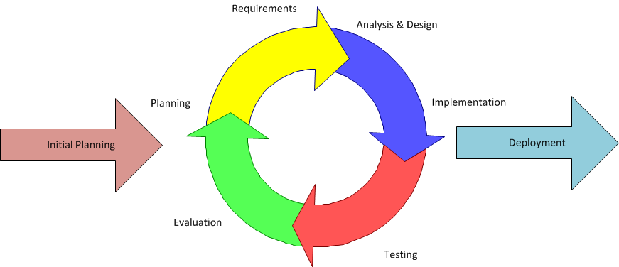
Iteration

Slide 13
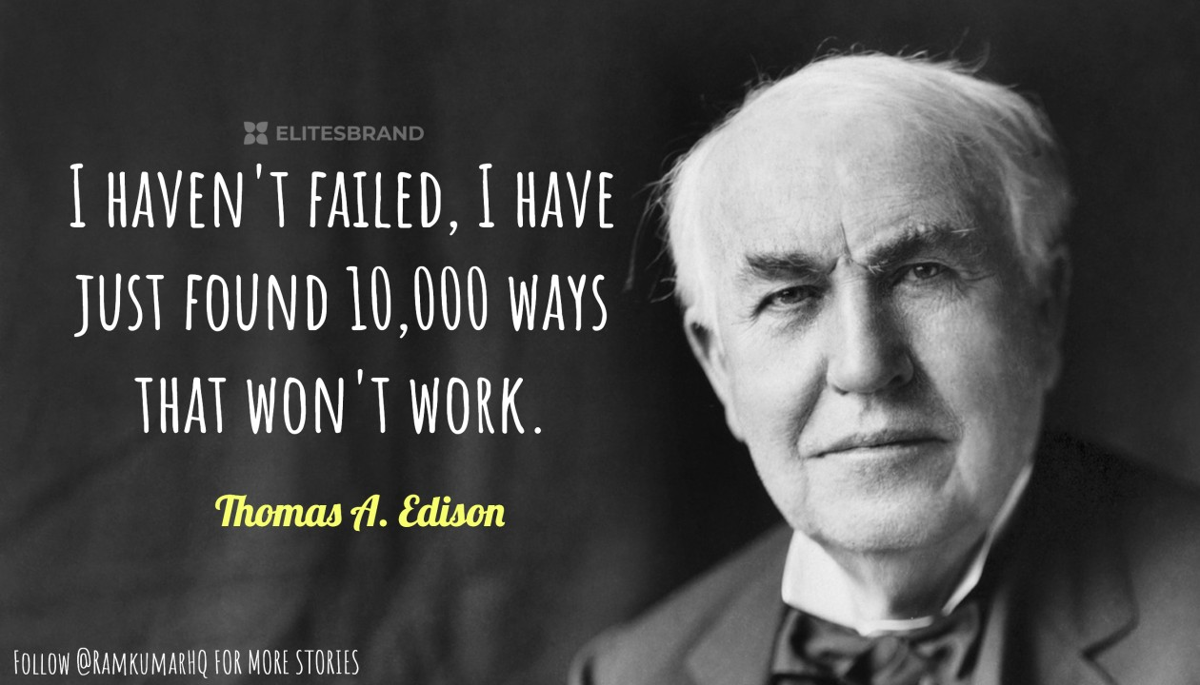
What is iteration?
Repeating and revising a process
Purpose:
  Identify the true goal (rarely is this ever the initial goal)
  Smooth out any issues
  Essential for business, engineering, social sciences, anywhere

Slide 14
Question Exercise
Use iteration to come up with a “better” research question than the original
Original: How can we improve math education for high school students?

Slide 15


Slide 16

Thinking is hard

Slide 17

Gathering Data

Slide 18


Slide 19
Onto Kaggle!
https://www.kaggle.com/datasets/rkiattisak/student-performance-in-mathematics
https://www.kaggle.com/datasets/janiobachmann/math-students
https://www.kaggle.com/datasets/soumyadiptadas/students-math-score-for-different-teaching-style
https://www.kaggle.com/datasets/mathurinache/math-dataset
https://www.kaggle.com/datasets/whenamancodes/student-performance

Slide 20

Data Driven

Slide 21
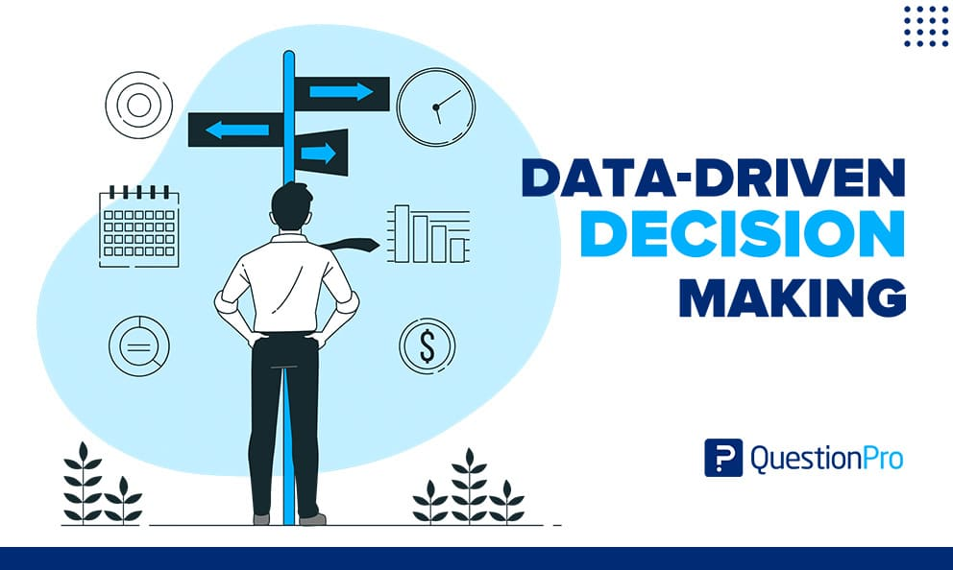

Slide 22
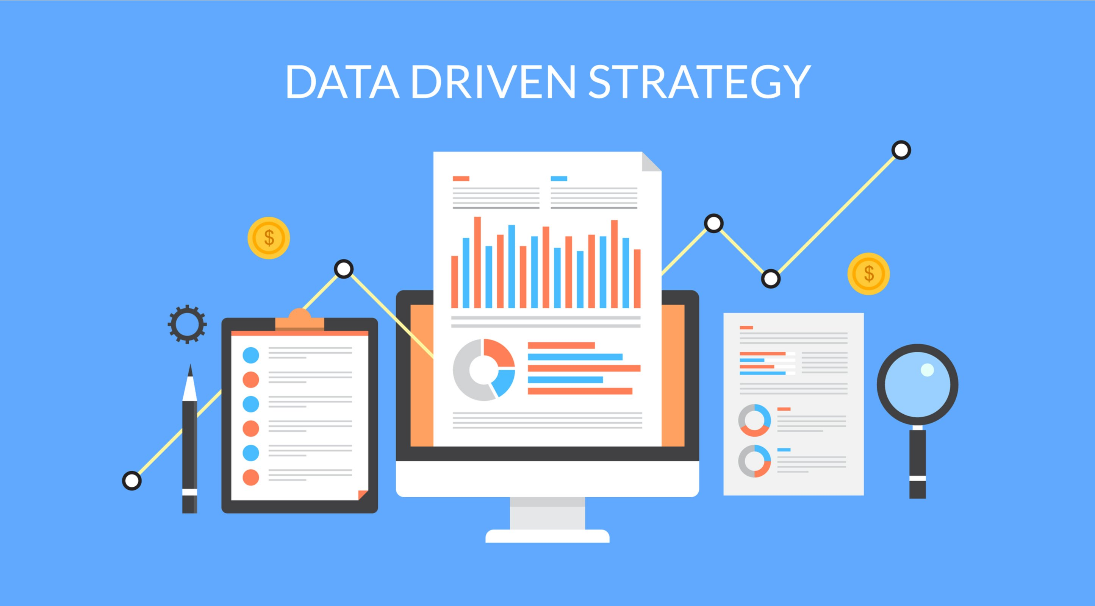

Slide 23
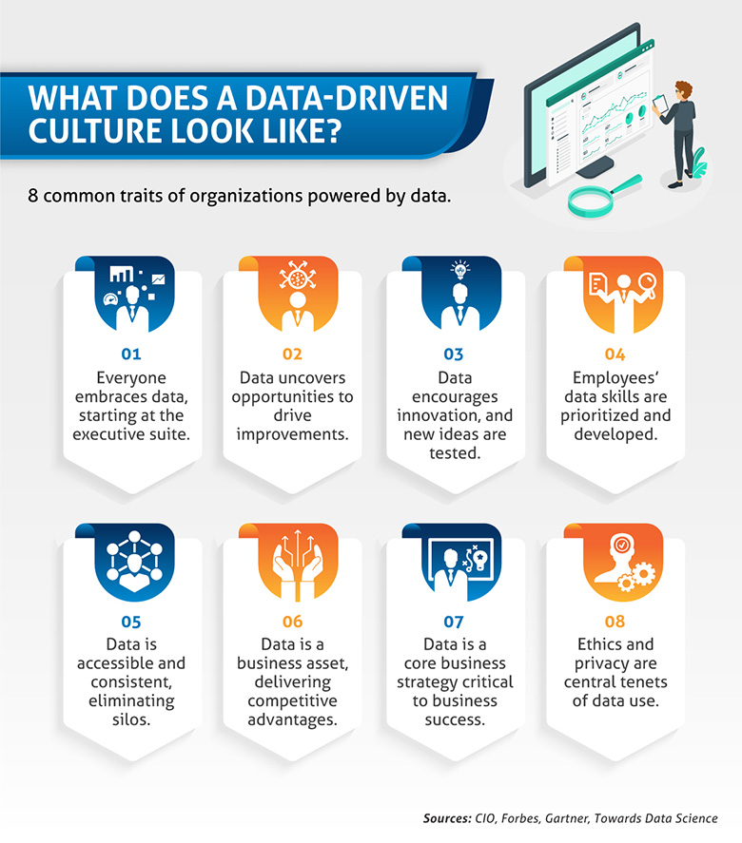

Slide 24
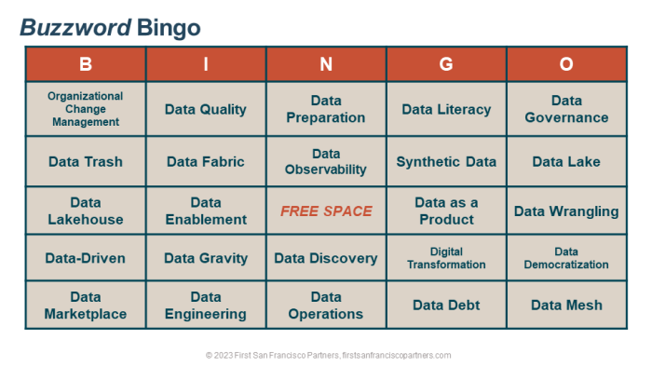

Slide 25

Data Driven

Slide 26
What does it mean to be data driven?

Slide 27
What does it mean to be data driven?
Buzzword

Slide 28
What does it mean to be data driven?
Buzzword
Make progress or generate ideas based on data

Slide 29
What does it mean to be data driven?
Buzzword
Make progress or generate ideas based on data
New ideas are more likely to come from outside experience rather than personal intuition

Slide 30
Question Exercise: Data Driven!!!
Use data to come up with a “better” research question than the original
Original:

Slide 31

Writing Reports

Slide 32
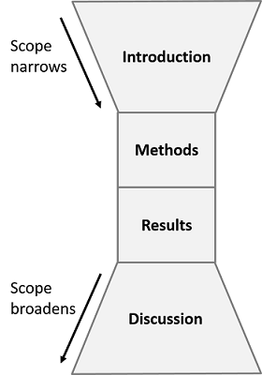
Why does this work?
Because it makes sense!
A good report is familiar and easy to follow
Unless you are writing specifically about the mathematics, your goal is to put the statistics in context

Slide 33
Why does this work?
Because it makes sense!
A good report is familiar and easy to follow
Unless you are writing specifically about the mathematics, your goal is to put the statistics in context
We will look into various methods next week
We will focus primarily on results and discussions today

Slide 34
Research Paper Preview
(Google Colab)

Slide 35
Writing Statistical Analyses
For most instances, statistics will be used as a tool to interpret data
  There exist papers purely on statistical methods, but those won’t be the focus
Bottom Line: Always provide context

Slide 36
Statistical Analysis Example
Context: You want to calibrate a machine that fills 2-liter soda bottles. You run the machine to fill 30 2-liter soda bottles. You calculated the statistics below:

Slide 37
Statistical Analysis Example
Context: You want to calibrate a machine that fills 2-liter soda bottles. You run the machine to fill 30 2-liter soda bottles. You calculated the statistics below:
Sample average: 2.05 liters
Sample standard deviation: 0.24 liters
Test statistic: z = 1.141
P-value: 0.2539
Note: If n is “sufficiently large,” calculating a z or t statistic will yield nearly identical p-values

Slide 38
Statistical Analysis Example
Context: You want to calibrate a machine that fills 2-liter soda bottles. You run the machine to fill 30 2-liter soda bottles. You calculated the statistics below:
Sample average: 2.05 liters
Sample standard deviation: 0.24 liters
Test statistic: z = 1.141
P-value: 0.2539
Note: If n is “sufficiently large,” calculating a z or t statistic will yield nearly identical p-values
Bad Analysis:
  The sample average is 2.05 liters with a sample standard deviation of 0.24 liters. With a sample size of 30, the test statistic is 1.141 with a p-value of 0.2539.

Slide 39
Statistical Analysis Example
Context: You want to calibrate a machine that fills 2-liter soda bottles. You run the machine to fill 30 2-liter soda bottles. You calculated the statistics below:
Sample average: 2.05 liters
Sample standard deviation: 0.24 liters
Test statistic: z = 1.141
P-value: 0.2539
Note: If n is “sufficiently large,” calculating a z or t statistic will yield nearly identical p-values
Bad Analysis:
  The sample average is 2.05 liters with a sample standard deviation of 0.24 liters. With a sample size of 30, the test statistic is 1.141 with a p-value of 0.2539.
  Bad because of all the statistics jargon with no real interpretation.

Slide 40
Statistical Analysis Example
Context: You want to calibrate a machine that fills 2-liter soda bottles. You run the machine to fill 30 2-liter soda bottles. You calculated the statistics below:
Sample average: 2.05 liters
Sample standard deviation: 0.24 liters
Test statistic: z = 1.141
P-value: 0.2539
Note: If n is “sufficiently large,” calculating a z or t statistic will yield nearly identical p-values
Bad Analysis:
  The sample average is 2.05 liters with a sample standard deviation of 0.24 liters. With a sample size of 30, the test statistic is 1.141 with a p-value of 0.2539.
  Bad because of all the statistics jargon with no real interpretation.
Better Analysis:
  On average, the machine fills 2-liter soda bottles with 2.05 liters with a standard deviation of 0.24 liters. There is no statistically significant deviation from the expected 2 liters, suggesting that the machine is calibrated correctly.

Slide 41
Statistical Analysis Example
Context: You want to calibrate a machine that fills 2-liter soda bottles. You run the machine to fill 30 2-liter soda bottles. You calculated the statistics below:
Sample average: 2.05 liters
Sample standard deviation: 0.24 liters
Test statistic: z = 1.141
P-value: 0.2539
Note: If n is “sufficiently large,” calculating a z or t statistic will yield nearly identical p-values
Bad Analysis:
  The sample average is 2.05 liters with a sample standard deviation of 0.24 liters. With a sample size of 30, the test statistic is 1.141 with a p-value of 0.2539.
  Bad because of all the statistics jargon with no real interpretation.
Better Analysis:
  On average, the machine fills 2-liter soda bottles with 2.05 liters with a standard deviation of 0.24 liters. There is no statistically significant deviation from the expected 2 liters, suggesting that the machine is calibrated correctly.
  Better because there is context

Slide 42
Questions?

